Slide 1
Ch 4 – Moving Charges and Magnetism

Slide 2
Intro:
This chapter introduces the fundamental concepts of magnetism, focusing on how moving electric charges and currents create magnetic fields and how these magnetic field exert forces on other moving charges and currents

Slide 3
Intro:
Magnetic fields exert forces on moving charged particles and current-carrying wires.
Currents also produce magnetic fields. (Oersted’s Experiment: Current carrying wire produces magnetic field)
The chapter will discuss how particles are accelerated in devices like the cyclotron and how galvanometers detect currents and voltages
Convention: A dot (•) depicts a current or field emerging out of the plane of the paper, while a cross (×) depicts a current or field going into the plane of the paper

Slide 4
Magnetic Field:
The region surrounding a magnet or a moving electric charge within which its magnetic influence can be experienced is called the magnetic field.“
In more precise terms for a moving charge:
"The magnetic field B⃗ at a point is defined as the force experienced per unit positive charge moving with a unit velocity perpendicular to the magnetic field."

Slide 5
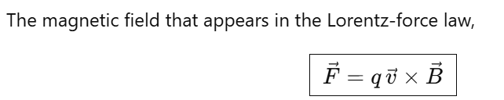
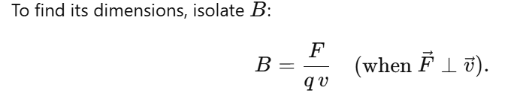
Dimensional formula for magnetic field:

Slide 6
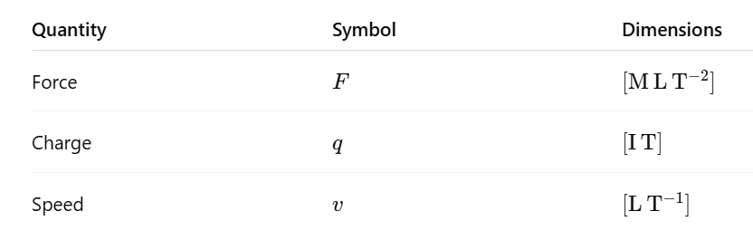
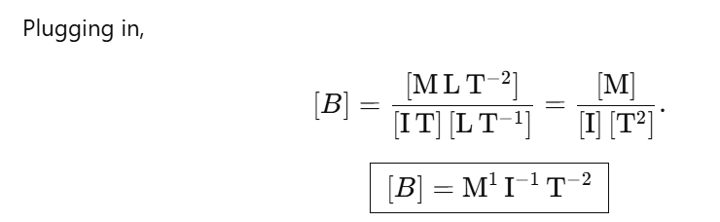
Dimensional formula for magnetic field:

Slide 7
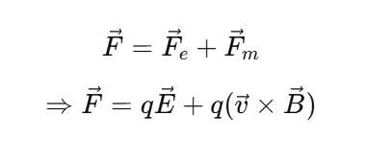
Lorentz force:
It is the net force experienced by a charged particle when it is in region of both electric field and magnetic field.

Slide 8
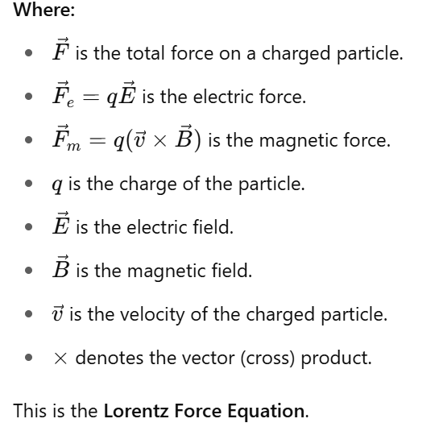
Lorentz force:

Slide 9
Magnetic Force
Sources of Magnetic Field: Just as static charges produce an electric field, currents or moving charges produce a magnetic field, denoted by B(r), which is a vector field.
Principle of Superposition: The magnetic field due to multiple sources is the vector sum of the magnetic fields from each individual source
Magnetic Force on a Charged Particle (Lorentz Force): A moving charged particle of charge q with velocity v experiences a force in a magnetic field B. This magnetic force F is given by F = q (v × B)

Slide 10
Magnetic Force
The direction of the magnetic force on a positive charge is given by the right-hand rule (or screw rule) for the cross product v × B. For a negative charge, the force is in the opposite direction.
The magnetic force does no work on a moving charged particle, as the force is always perpendicular to the velocity

Slide 11
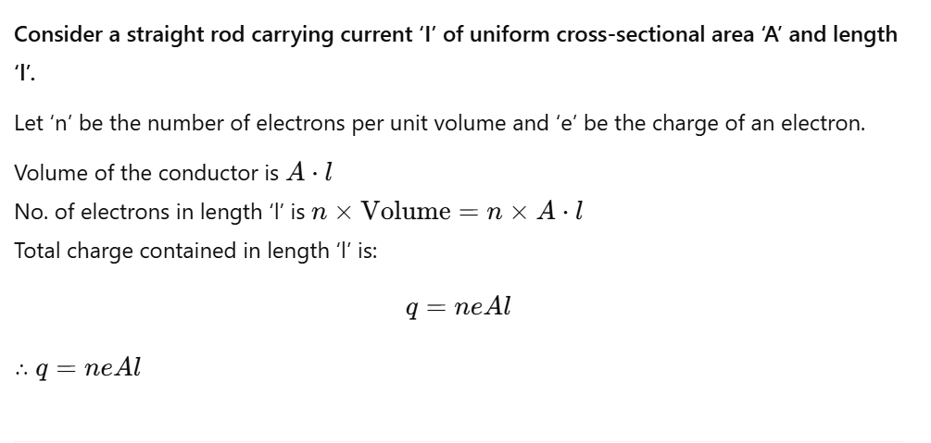
Magnetic Force on a Current-Carrying Conductor:

Slide 12
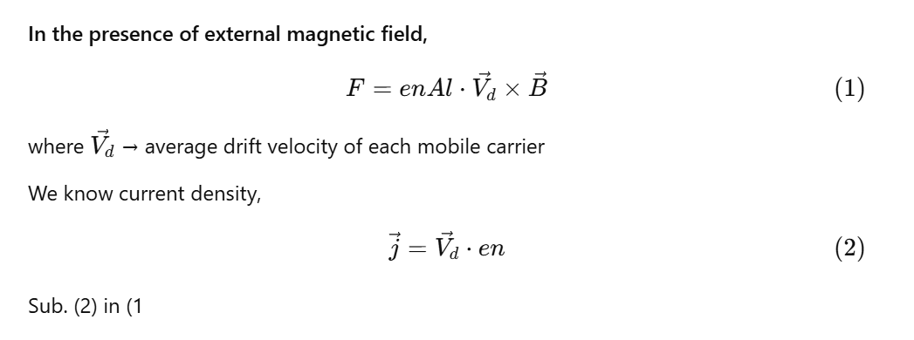
Magnetic Force on a Current-Carrying Conductor:

Slide 13
Magnetic Force on a Current-Carrying Conductor:
In the presence of an external magnetic field B, the force F on current carriers in a conductor of length l carrying current I is given by
F = I (l × B)
Here, l is a vector whose magnitude is the length of the rod and whose direction is identical to the current I

Slide 14
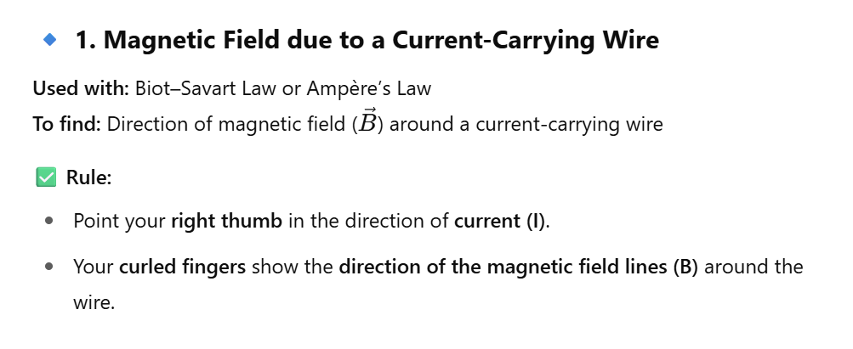

Slide 15
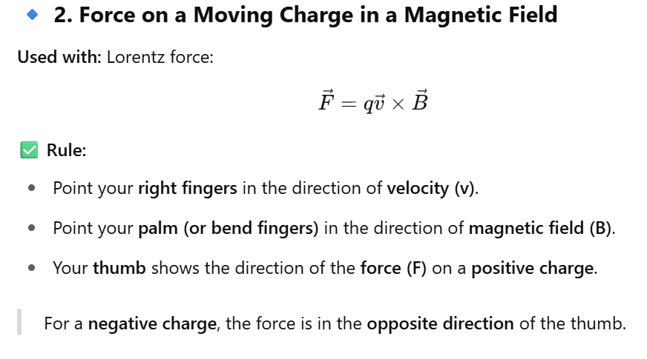

Slide 16
Motion in a Magnetic Field
When you keep a charged particle in the presence of electric field and magnetic field, the electric field E vector provides electrostatic force acting on the charged particle that provides acceleration to the particle and magnetic field B vector provides magnetic force that doesn't speed up the particle, instead it changes the direction of the charged particle.

Slide 17
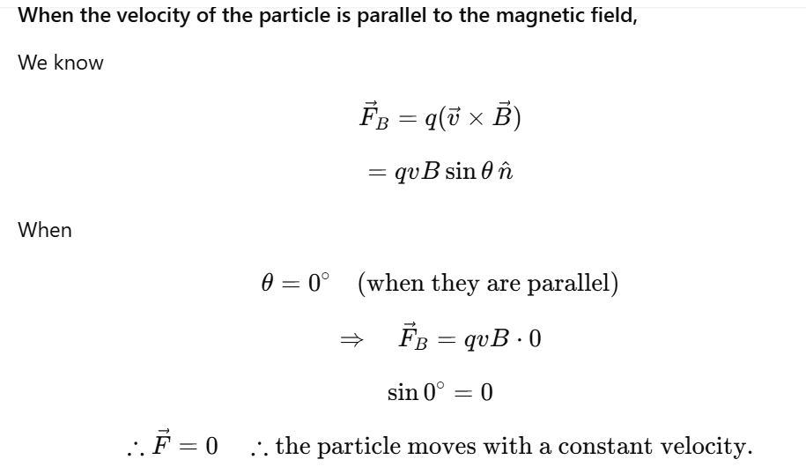
Motion in a Magnetic Field

Slide 18
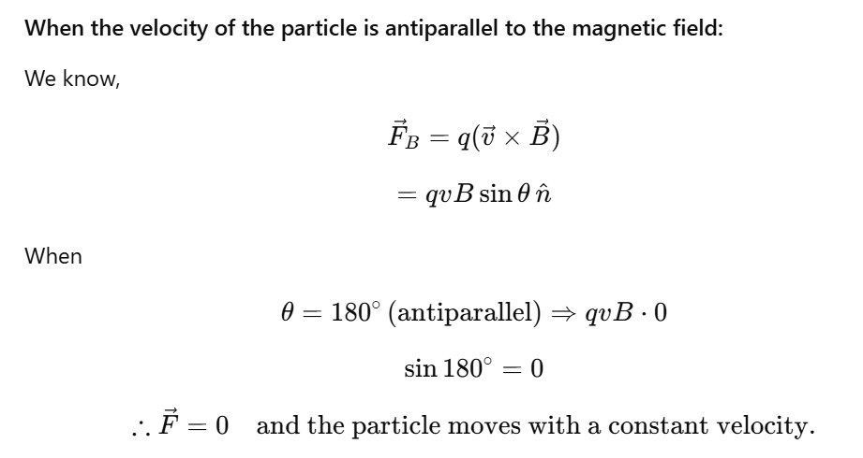
Motion in a Magnetic Field

Slide 19

Motion in a Magnetic Field
Refer pg.no 112, Figure 4.5; where the velocity of the particle is perpendicular to the magnetic field.
Since V and B are perpendicular in our case, curl your fingers from V to B, then force will be along the radius(towards the center).

Slide 20
Motion in a Magnetic Field
When a charged particle moves in a magnetic field, the magnetic force being perpendicular to the velocity means it does no work and thus does not change the particle's kinetic energy or speed, only its direction of motion.
This perpendicular force acts as centripetal force and produces circular motion. The particle will describe a circle.

Slide 21
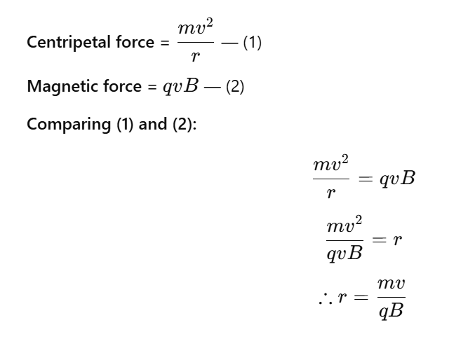
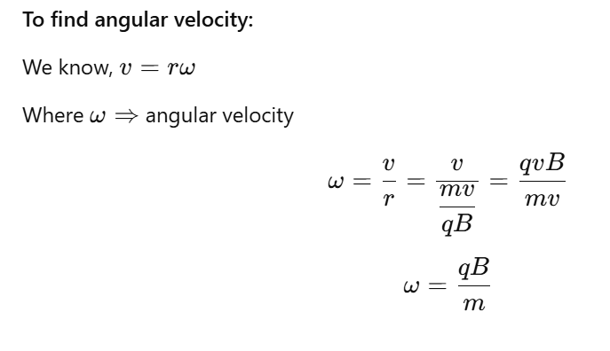
Motion in a Magnetic Field

Slide 22
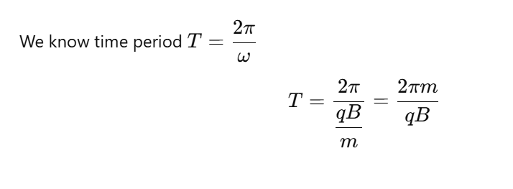
Motion in a Magnetic Field:

Slide 23
BIOT–SAVART’S LAW:
The magnitude(strength) dB of the magnetic field at any point around the current-carrying conductor:
is directly proportional to current
is directly proportional to the length of the wire dl
is directly proportional to sine of angle between length of the wire dl and position vector r
and is inversely proportional to the square of distance between them

Slide 24
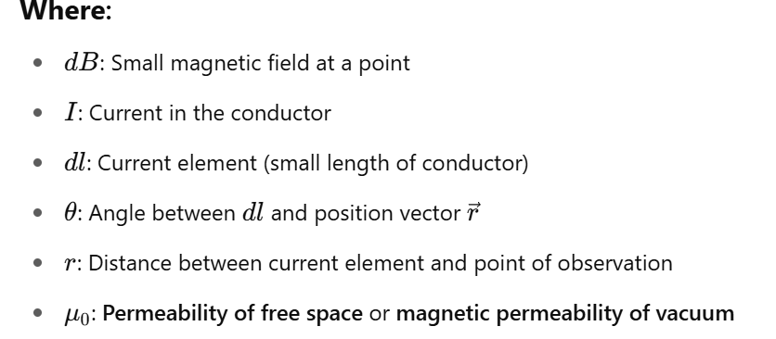
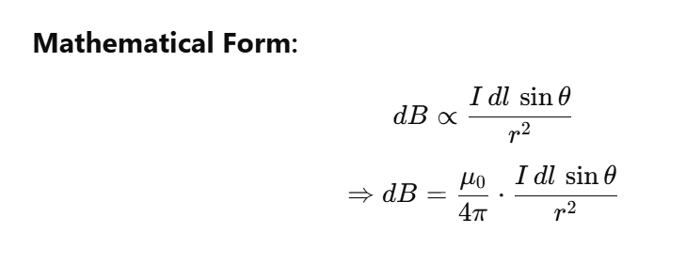
BIOT–SAVART’S LAW:

Slide 25
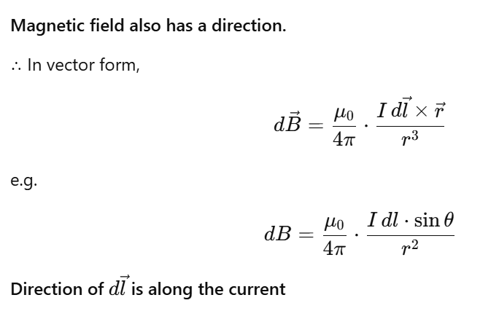

Slide 26
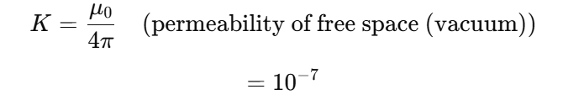

Slide 27
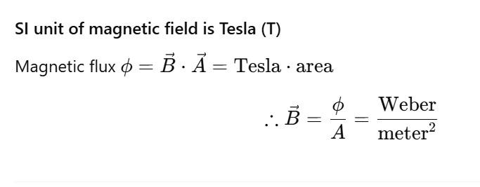

Slide 28
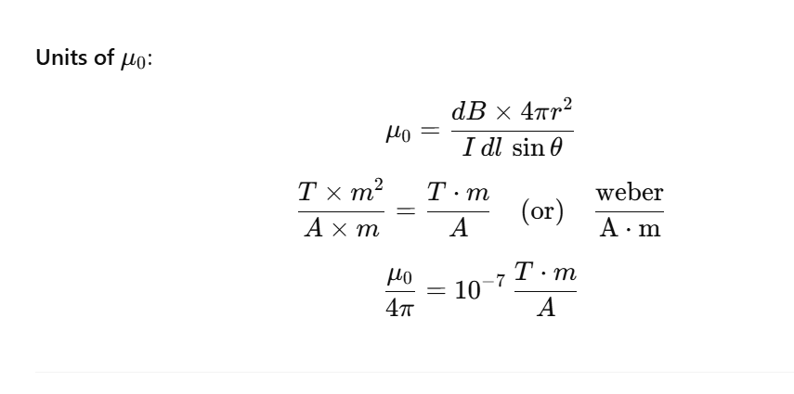

Slide 29
Cyclotron:
This is a device used to accelerate charged particles to very high energies. It uses both electric and magnetic fields. A high-frequency alternating voltage is applied to dees (D-shaped metallic chambers), and a uniform magnetic field bends the particle paths into spirals.
The period of revolution (T) is independent of the speed of the particle.

